Slide 1
Sources for Case Studies

Slide 2
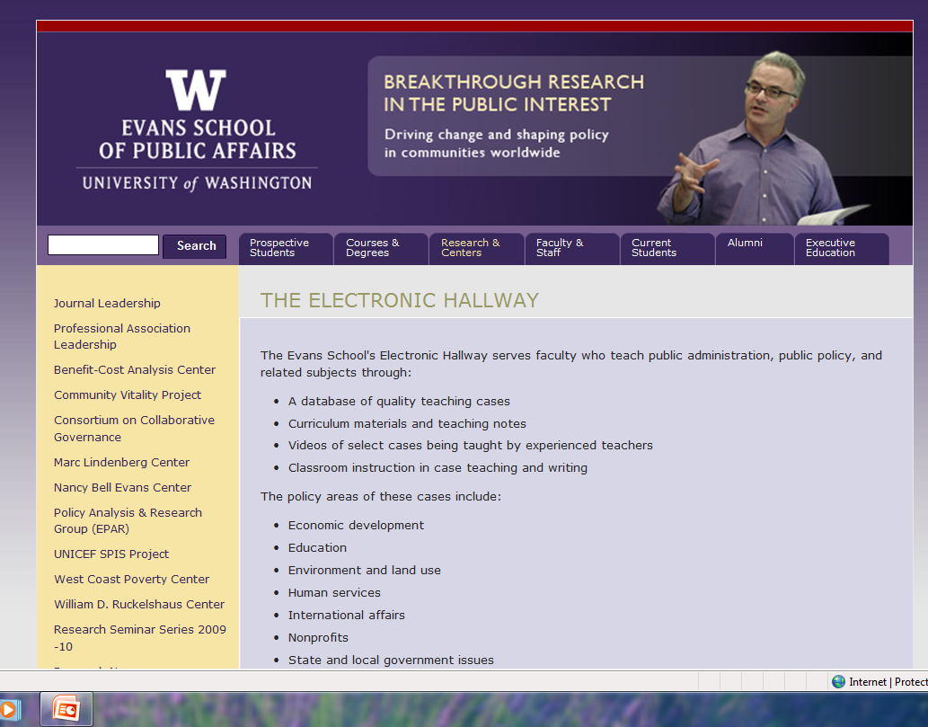
The Electronic Hallway
http://hallway.evans.washington.edu

Slide 3
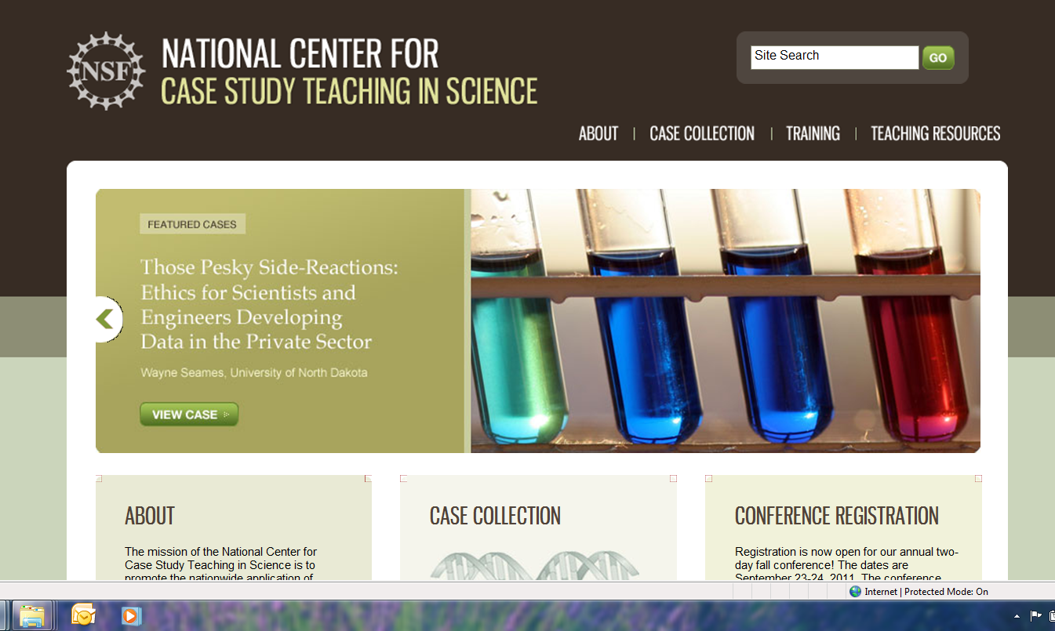
National Center for Case Study Teaching in Science
http://sciencecases.lib.buffalo.edu/cs/

Slide 4
EECH- The Case for Learning
www.eech.com

Slide 5
Search the websites of Universities by keyword
http://www.podnetwork.org/search.htm

